Slide 1

The WEIRD Problem in a“Non-WEIRD” Context: A Meta-Research on the Representativeness of Human Subjects in Chinese Psychological Research
岳磊 左西年 胡传鹏* 2024.01.21
*通讯作者：hcp4715@hotmail.com
华中师范大学研究生会

Slide 2

Introduction
Method
Content
Preliminary results
Research progress

Slide 3
01
Introduction

Slide 4
Research background
Psychological science aims at understanding human mind and behaviour. However, psychological science largely relies on unrepresentative human samples: most human participants in published psychological studies are undergraduate students who take psychology courses from “Western, Educated, Industrialized, Rich, and Democratic” regions (Henrich et al., 2010a; Henrich et al., 2010b; Henry, 2008; Sears, 1986)
WEIRD
华中师范大学研究生会

Slide 5
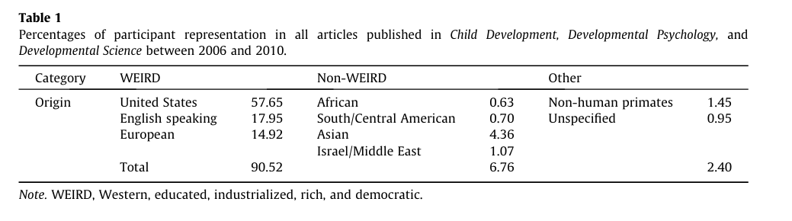
Research background
Nielsen et al. 2017
华中师范大学研究生会

Slide 6
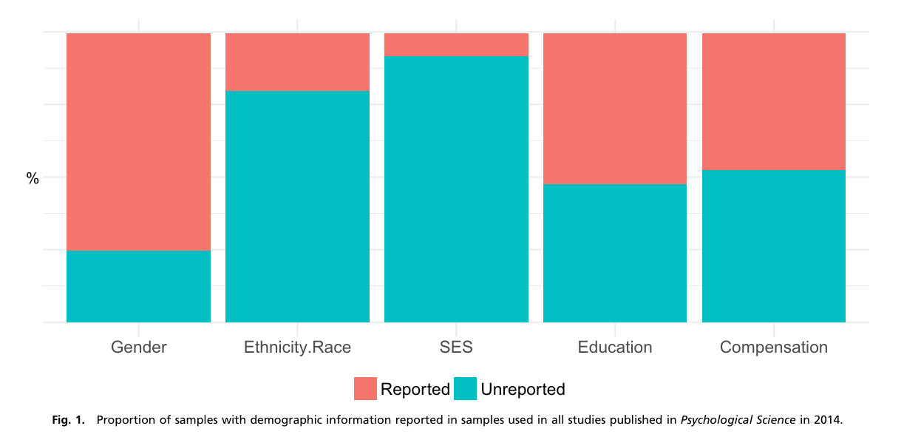
Research background
Rad et al. 2018 PNAS
华中师范大学研究生会

Slide 7
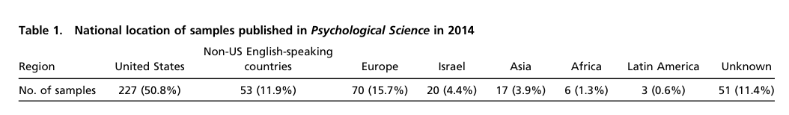
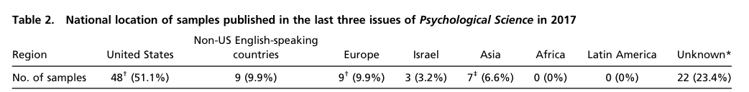
Research background
Rad et al. 2018 PNAS
华中师范大学研究生会

Slide 8
Research background
Note: 本图由Rad et al. 2018和2022世界人口数据整合而成。
华中师范大学研究生会

Slide 9
Research background
limitting our understanding of the whole picture of human mind and behaviour
WEIRD problem
leading to incorrect policies
华中师范大学研究生会

Slide 10
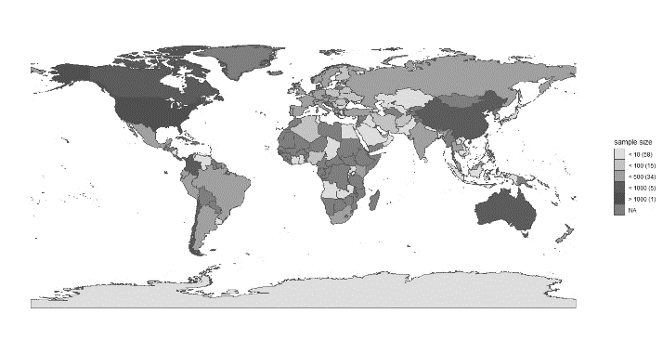
Research background
？
Representativeness？
International collaborations projects
PSA
Human Penguin Project
Non_WEIRD data
Asia, Middle East,
Latin America, and Africa
华中师范大学研究生会

Slide 11
Question and hypothesis
问题1：来自中国五大权威心理学期刊中的被试特征与来自国际合作项目中的中国被试特征是否相似？
相似
问题2：与人口普查数据和CFPS相比，心理学研究中的中国被试在多大程度上能代表中国人？
代表性差
问题3：其国家或地区被研究的对象是否和中国的被试有一样的特征？
是
华中师范大学研究生会

Slide 12
02
Method

Slide 13
Data resource
中国临床心理学
心理学报
心理与行为研究
心理科学
心理发展与教育
...
Journal
Data source
International collaborations projects
华中师范大学研究生会

Slide 14
Data resource
中国临床心理学
Wang et al. (2021)
2017~2018 500 Articles
心理学报
心理与行为研究
心理科学
心理发展与教育
...
2008 250 Articles
2020~2021 250 Articles
Journal
1000 Articles
王珺 等. (2021). 解读不显著结果：基于500个实证研究的量化分析. 心理科学进展 , 29(3), 381-393.
华中师范大学研究生会

Slide 15
Data resource
Journal | 2008 | 2017~2018 | 2020~2021
Acta Psychological Sinica | 138 (39) | 246 (95) | 91 (28)
Journal of Psychological Science | 379 (107) | 299 (115) | 203 (61)
Chinese Journal of Clinical Psychology | 227 (64) | 379 (146) | 310 (94)
Psychological Development and Education | 87 (24) | 162 (62) | 95 (29)
Psychological and Behavioral Studies | 57 (16) | 213 (82) | 125 (38)
Note: Each column includes the total number of articles published in each journal at that time interval and the number of articles selected (inside parentheses)
华中师范大学研究生会

Slide 16
Data resource
20081001
20081001
20081002
20081002
20083053
20083053
20081001
20081002
20181053
20181053
心理学报
心理学报
20183053
20183053
20213053
20213053
Check
R
Article number
Data code
Random sampling
华中师范大学研究生会

Slide 17
Data code
Formal coding stage
pre-coding stage
Coding proofreading stage
华中师范大学研究生会

Slide 18
Data code
1000
Code manual
华中师范大学研究生会

Slide 19
Data code
Article basis info: title, first-author, journal…
Subjects info: gender, age, SES, subjects number,
subjects recruitment area…
Code manual
Other important info: target population,
sampling method, subjects recruitment method,
study type
华中师范大学研究生会

Slide 20

Data analysis
pre-process and visualise data
Bayes factor (Bayesian multinomial test)
华中师范大学研究生会

Slide 21
03
Preliminary results

Slide 22
Q2
We tested whether the sex ratio in psychological sample is different from that of the census data using the Bayesian multinomial test (Bayesian version of Goodness-of-fit). The results revealed strong evidence that the psychological sample data (Jones et al., 2021) is different from the census data, log(BF₁₀) = 3.73. In contrast to psychological sample data, data from sociology, CFPS 2018 data, is not different from census data, log(BF₁₀) = -2.06. As we can see from Figure 3 A, Chinese psychological science sample included more female participants, while the CFPS data has a similar pattern as the census data.
华中师范大学研究生会

Slide 23
Q2
For the age distribution, we found that the psychological samples’ age distribution is different from that of the census data, with strong evidence from the Bayesian multinomial test, log(BF₁₀) = 168.38. This difference is further revealed by the demographic pyramid (See figure 3 B), which showed that the Chinese psychological samples consist of females aged 15~24 years.
华中师范大学研究生会

Slide 24
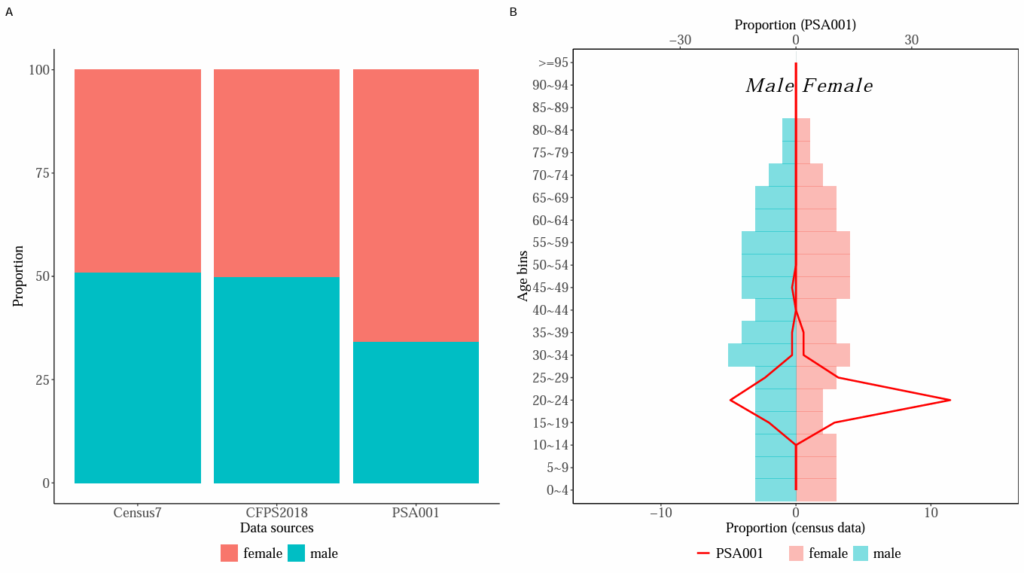
Q2
华中师范大学研究生会

Slide 25
Q3
For sex ratio, the pairwise Bayesian multinomial test revealed that data from 9 countries have different sex ratios as compared to Chinese psychological samples (see Figure 4A). Twenty-three countries have higher proportion of female participants than Chinese samples (see Figure 4C).
华中师范大学研究生会

Slide 26
Q3
For age distribution, the pairwise Bayesian multinomial test revealed strong evidence that samples from fourteen countries are the same as Chinese psychological samples (see Figure 4B, 4D). These preliminary results indicated that the psychological samples from many regions are similar, probably most of them are college students or communities around university campuses (Arnett, 2008), but also there is variability in both sex ratio and age distribution.
华中师范大学研究生会

Slide 27
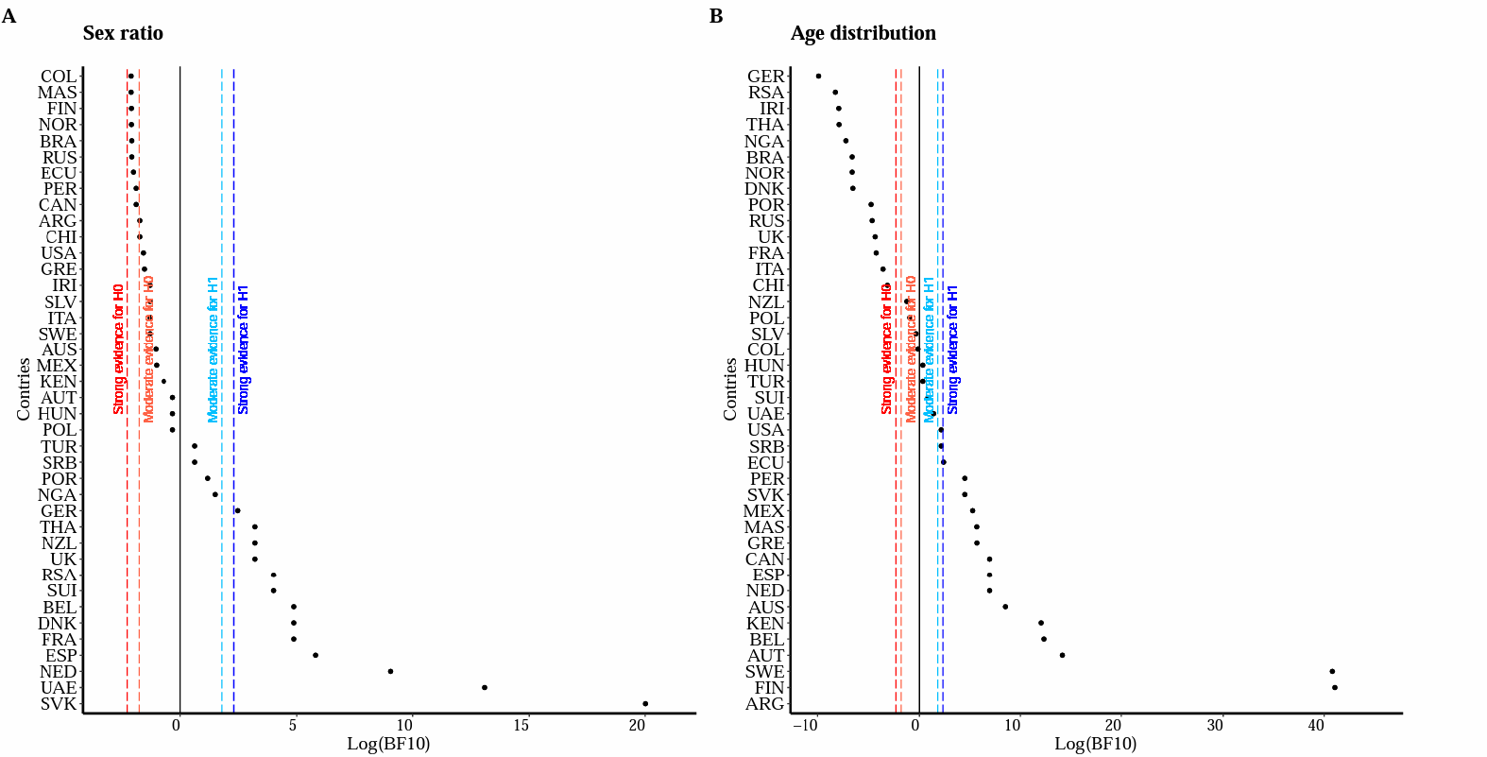
Q3
华中师范大学研究生会

Slide 28
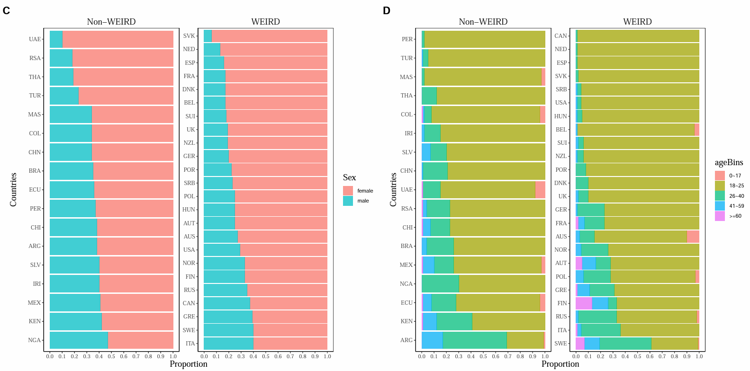
Q3
华中师范大学研究生会

Slide 29
Q3_supp
the pairwise Bayesian multinomial test revealed strong evidence that samples from eighteen countries are the same as Chinese psychological samples (see Figure S1a, S1b). These preliminary results was similar to the 5-bins approach for age bins. These results suggest that the psychological samples from many regions are similar, probably most of them are college students or communities around university campus (Arnett, 2008).
华中师范大学研究生会

Slide 30
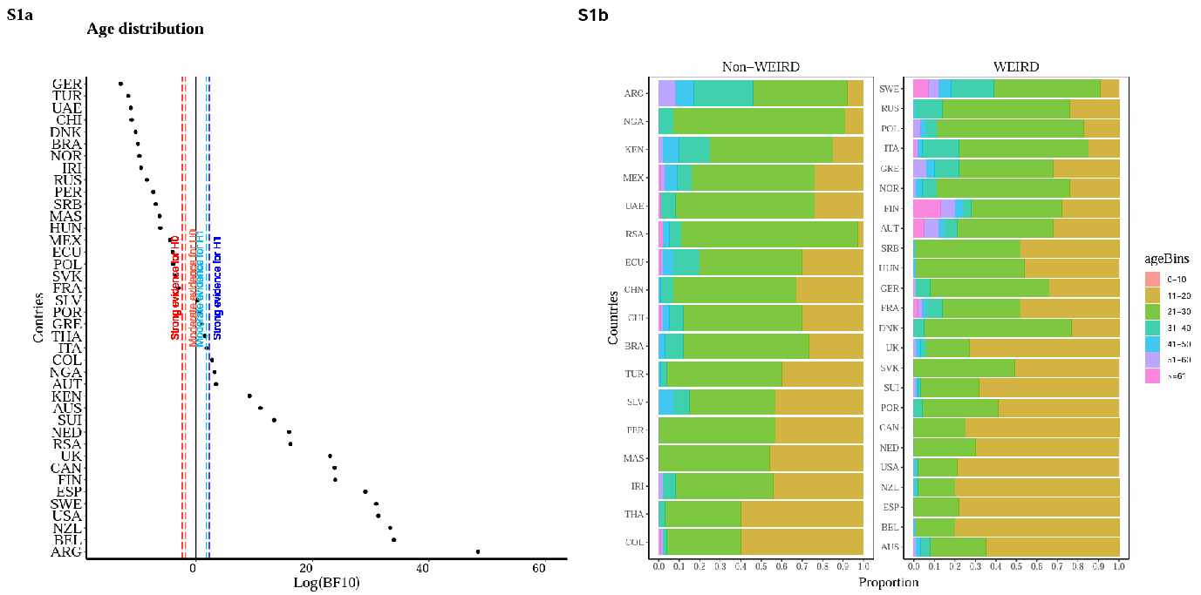
Q3_supp
华中师范大学研究生会

Slide 31
04
Research progress

Slide 32



Research progress
2021.03
2021.05
2021.09
赵加伟, 夏涛, 胡传鹏. (in press). 心理学研究中预注册的现状、挑战与建议. 心理科学进展
华中师范大学研究生会

Slide 33
Research progress
2 round +
3 round
5
Registered reports
Stage 1 in-principle acceptance 2023.04.03
Coding
华中师范大学研究生会

Slide 34
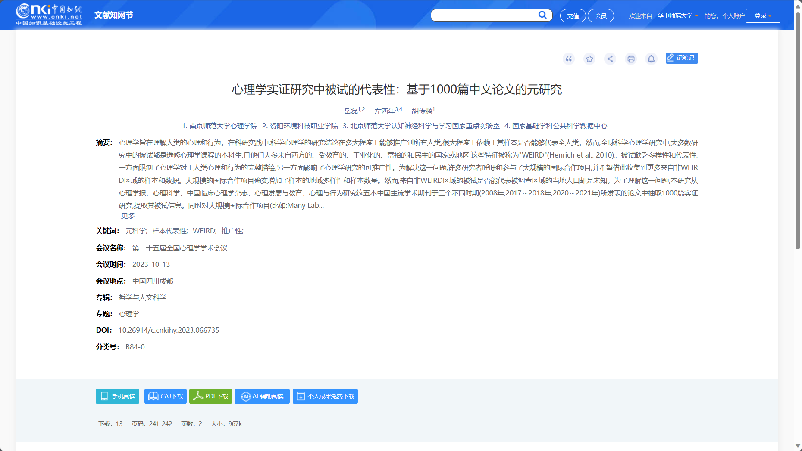

Research progress
2023.12.17 finish coding
Data pre-process and
data collection
2023 25th NACP
华中师范大学研究生会

Slide 35

Research progress
扫描二维码获取
我们的注册报告文档
华中师范大学研究生会

Slide 36
Other coder: 季小童，李窈，王欣，杨熙媛，王春晓，张涵，郝鑫，王琳，霍世图，魏浠羽，贝冬丽，徐洁，张威威，向静雯，林也，沙莹等等。

Slide 37

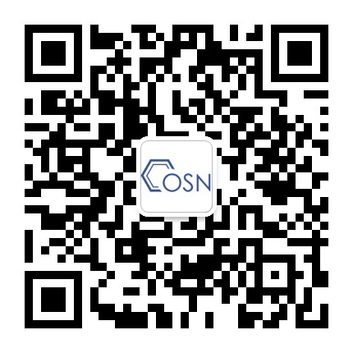

微信即可扫码关注公众号元自我和OpenScience

